Slide 1
Credit Card Scoring Model

Slide 2
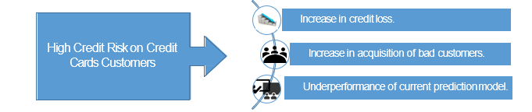
Introduction
CredX is a leading credit card provider that gets thousands of credit card applicants every year.
In the past few years, it has experienced an increase in credit loss.
In the past few years, it has experienced an increase in credit loss.

Slide 3
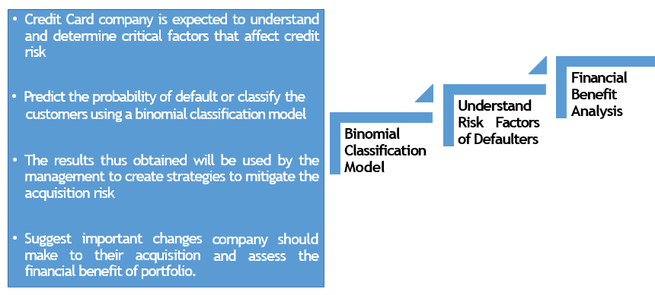
Objectives & Expectations

Slide 4
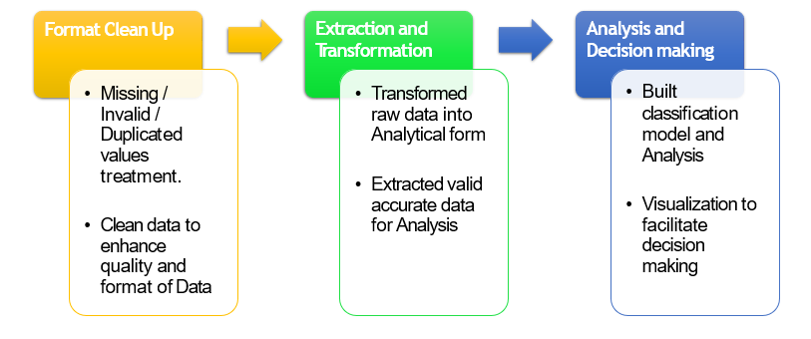
CRISP Analytics Process Followed : For Management Decision Support

Slide 5
Sanitised column name for ease of EDA and coding for data
files
Missing value treatment - by excluding
Treatment for invalid values - by substitution
Treatment for duplicated data - by substitution
Developing derived variables to bring more informative variables in the model
Create master customer information file by merging
demographic data and credit bureau data files
Substituting categorical variable by dummy variable
Outlier treatment (Capping) and scaling of continuous
variables to avoid undue over weightages to specific variables
Highlights of Data Cleaning and Enhancing

Slide 6
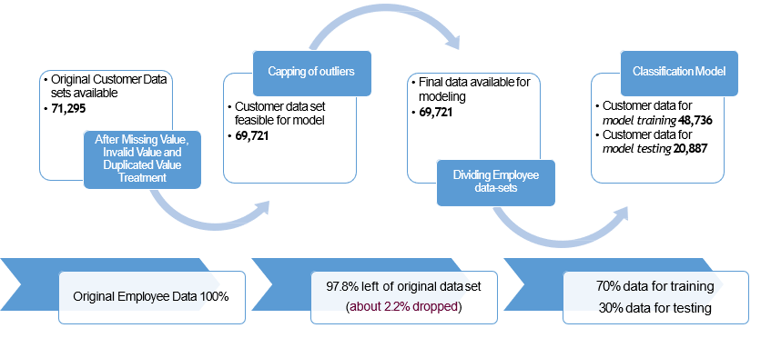
Quick glance on data preparation

Slide 7
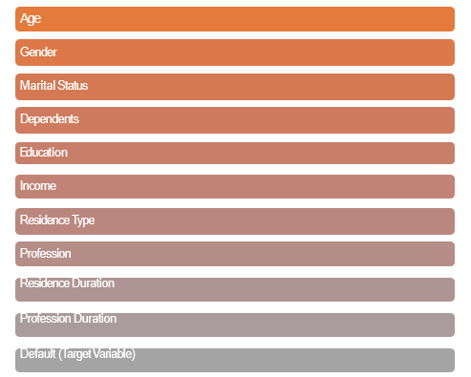
Application ID (Primary Key)
Age
Gender
Understanding Demographic Data

Slide 8
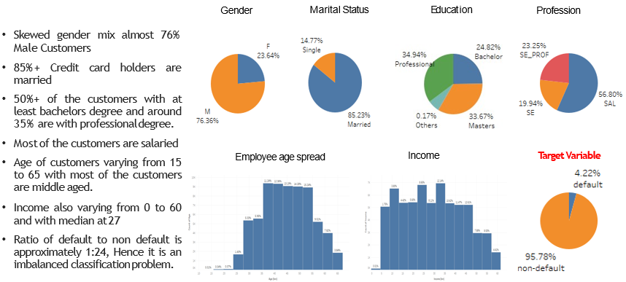
Customer Demography

Slide 9
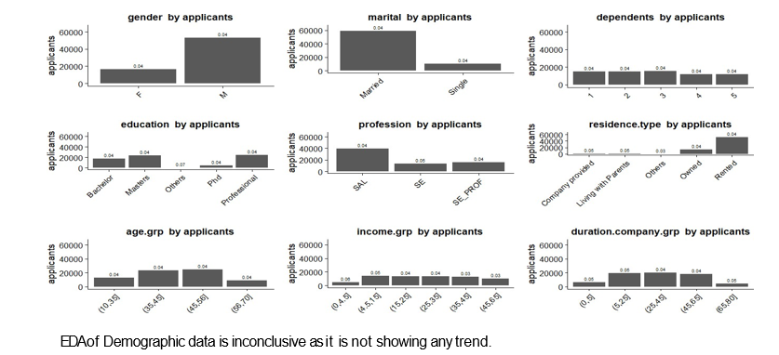
EDA of Demographic Data

Slide 10
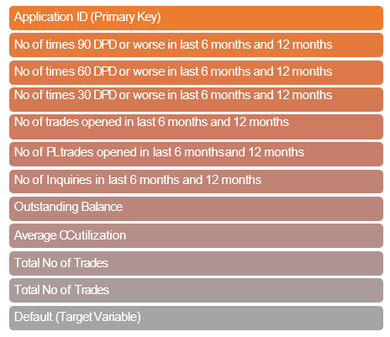
Understanding of Credit Bureau Data

Slide 11
EDA of Credit Bureau Data
Most of the variable contains outlier values
Credit Card utilisation contains most missing values
No. of PL trades is inversely proportional to default rate.
Home loan or Auto Loan are much of the influencing factor
Higher 30 DPD, 60 DPD and 90 DPD are promising indicator of default
Outstanding Balance > 4.5 M showing customer with high default rate
Higher the no. of inquiries in last 6M and 1Y shows the higher default rate.

Slide 12
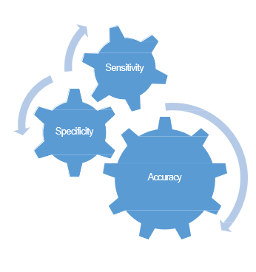
Models Developed
Demographic data
Logistic Regression Model
Demographic data and Credit Bureau Data
Lasso Regression Model
Considering applicants having 90 days DPD in past 12 months are as good as a defaulter (Basel II Guideline)
Random Forest Model
XGBoost Model

Slide 13
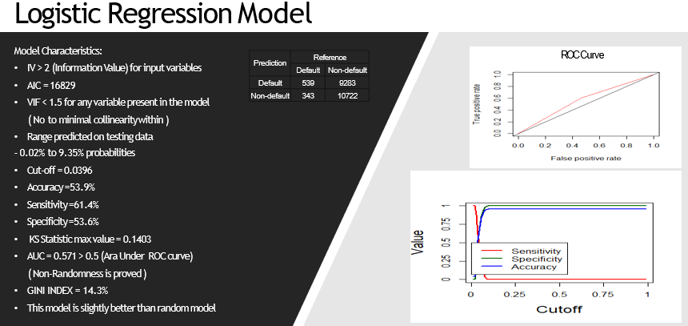

Slide 14
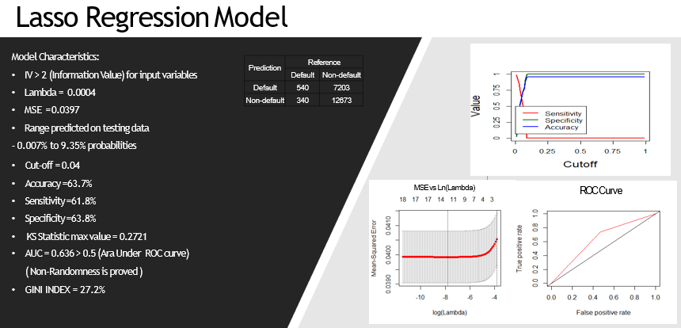

Slide 15
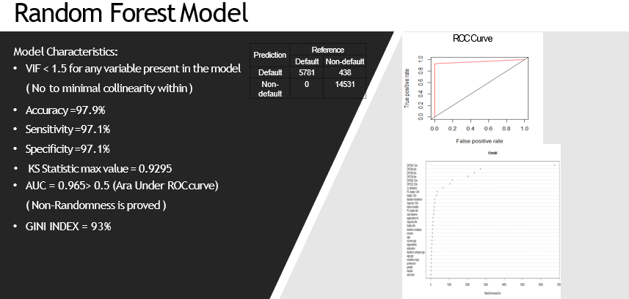

Slide 16
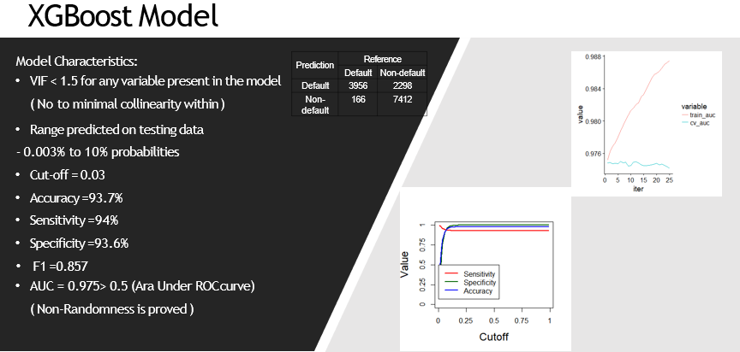

Slide 17
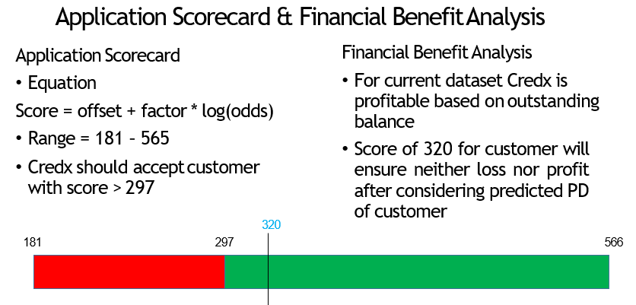

Slide 18
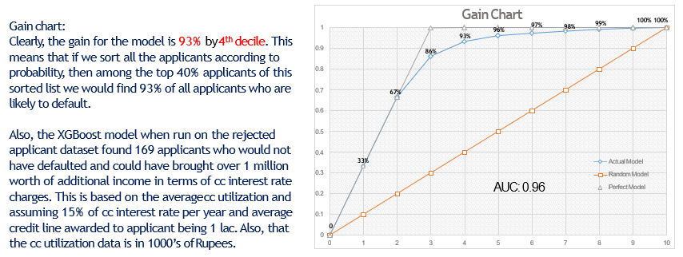
Financial Benefit Assessment

Slide 19
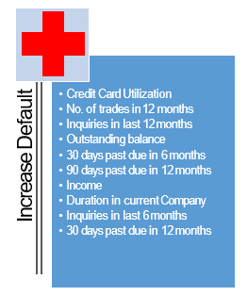

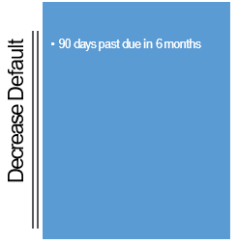

Variable | IV
cc.utilization | 30.65
trades.12m | 29.84
PL.trades.12m | 29.7
inquiries.12m | 29.64
outs.balance | 24.42
DPD30.6m | 24.19
total.no.trades | 23.72
PL.trades.6m | 21.97
DPD90.12m | 21.42
DPD60.6m | 20.62
inquiries.6m | 20.42
DPD30.12m | 19.79
trades.6m | 18.57
DPD60.12m | 18.5
DPD90.6m | 16.09
duration.residence | 7.89
income | 4.24
duration.company | 2.17
home.loan | 1.71

Slide 20
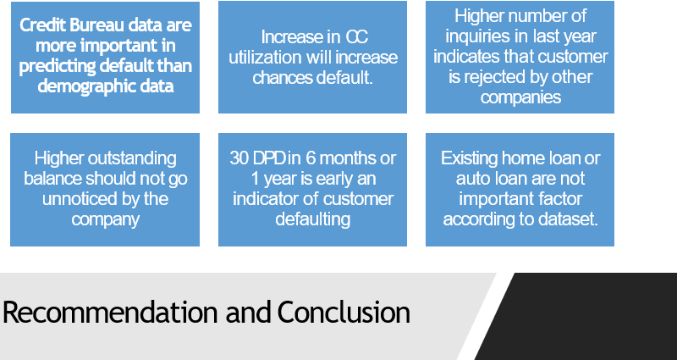

Slide 21
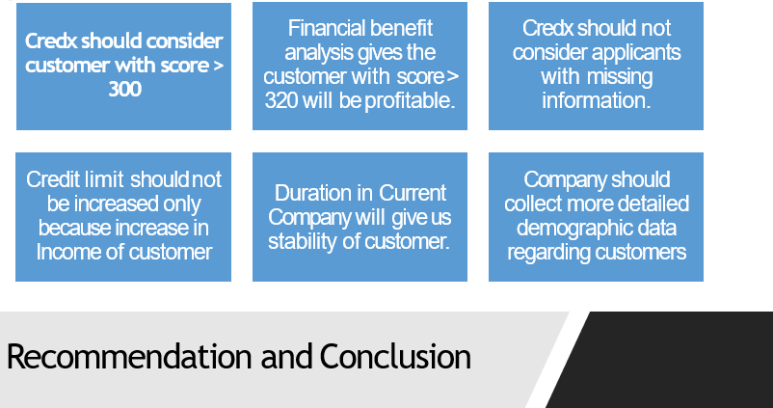

Slide 22
Thank You

